Slide 1

Center for Health Services Research
Data and Resources Available to Support
Health Services Research:
MarketScan, UKHC, and More
Jeffery Talbert, Institute for Biomedical Informatics
Alexandria Corbeau, Institute for Biomedical Informatics
Kelsey Karnik, Biostat CIRCL
Anthony Mangino, Biostat CIRCL
September 20, 2024

Slide 2
Agenda
Accessing Data through the CCTS
UKHC Data
MarketScan
Kentucky Hospital Discharge Data
Working with MarketScan Data
Biostat CIRCL

Slide 3
IRB Considerations
The CCTS has obtained approved IRB protocols that allow us to provide de-identified data (and some limited use data sets) to researchers at UK. Researchers do not have to have their own IRB protocol to receive deidentified information.
Some Limited Data Sets and fully identifiable datasets do require PIs to obtain IRB approval for their project.
Some projects may start out as deidentified, but may require IRB modifications if the data extract requires PHI.

Slide 4
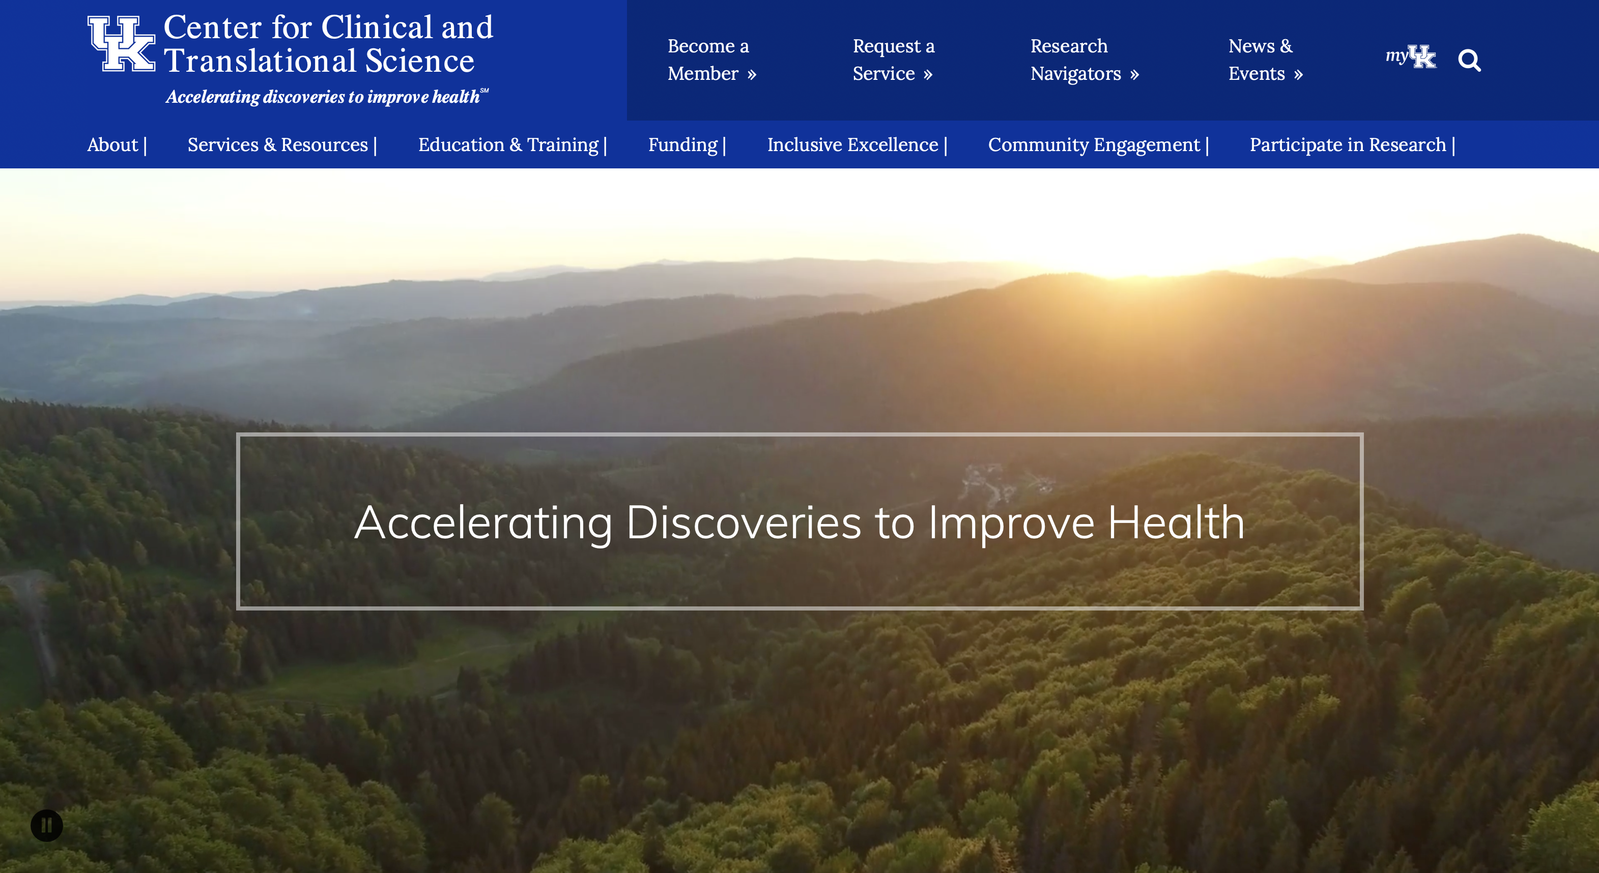

Slide 5
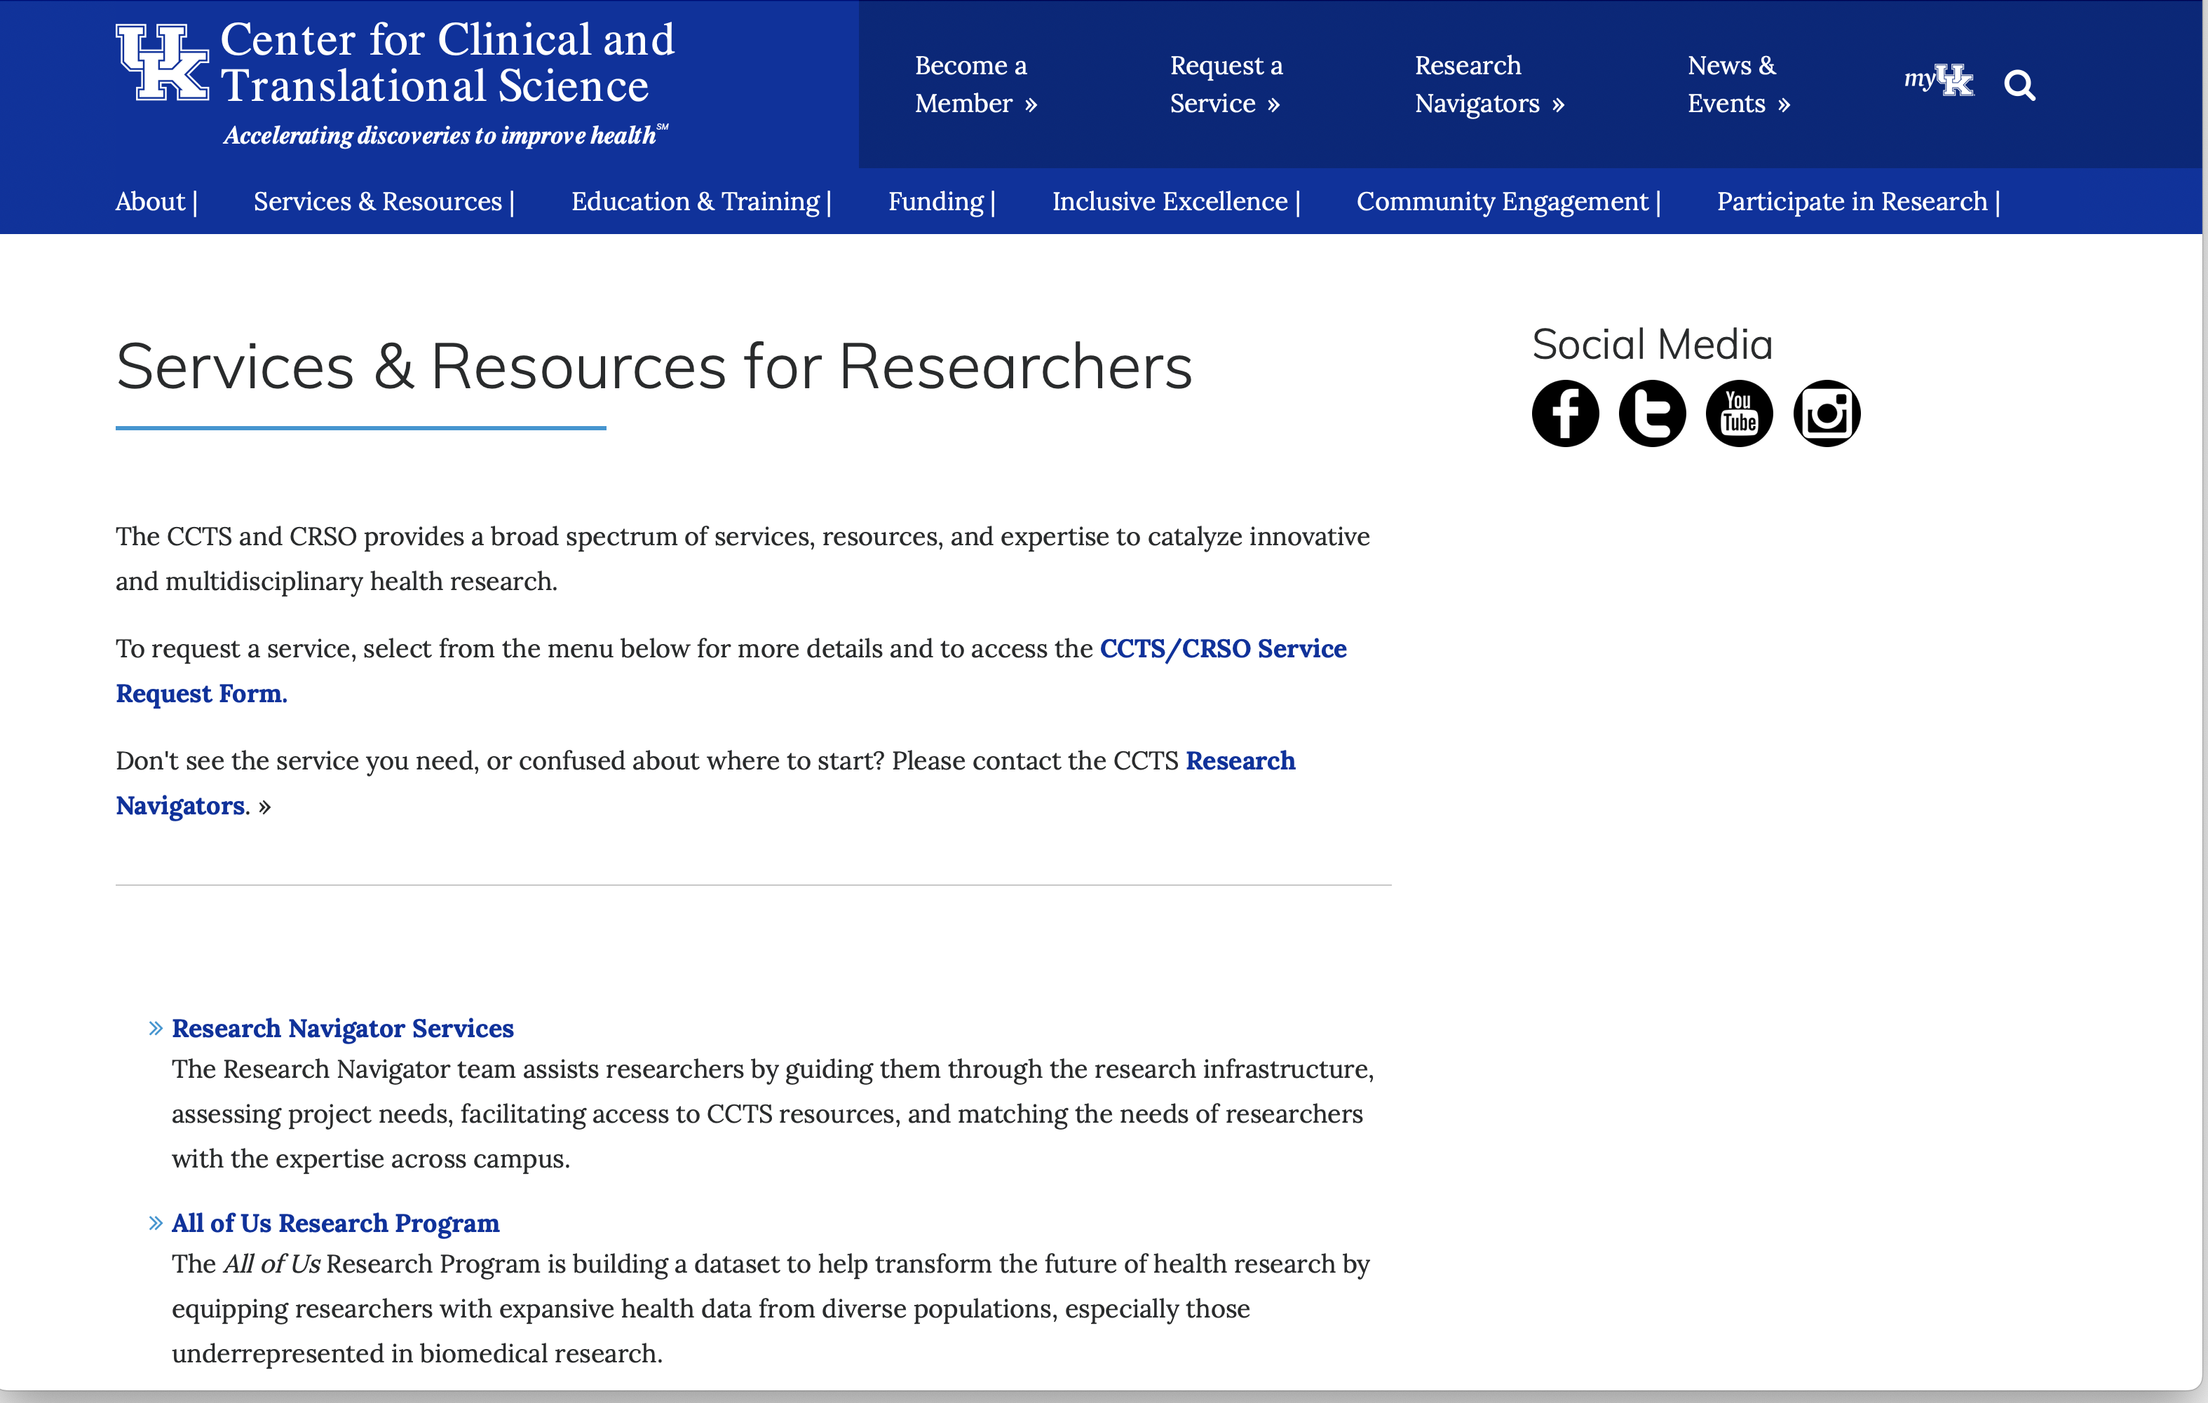

Slide 6

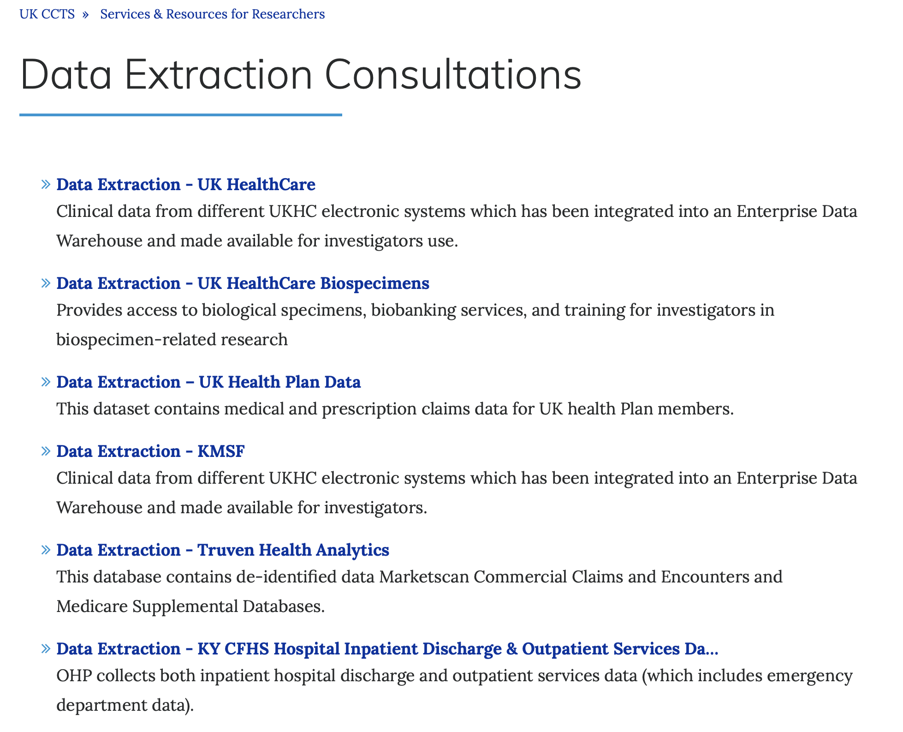
WWW.CCTS.UKY.EDU

Slide 7
WWW.CCTS.UKY.EDU

Slide 8
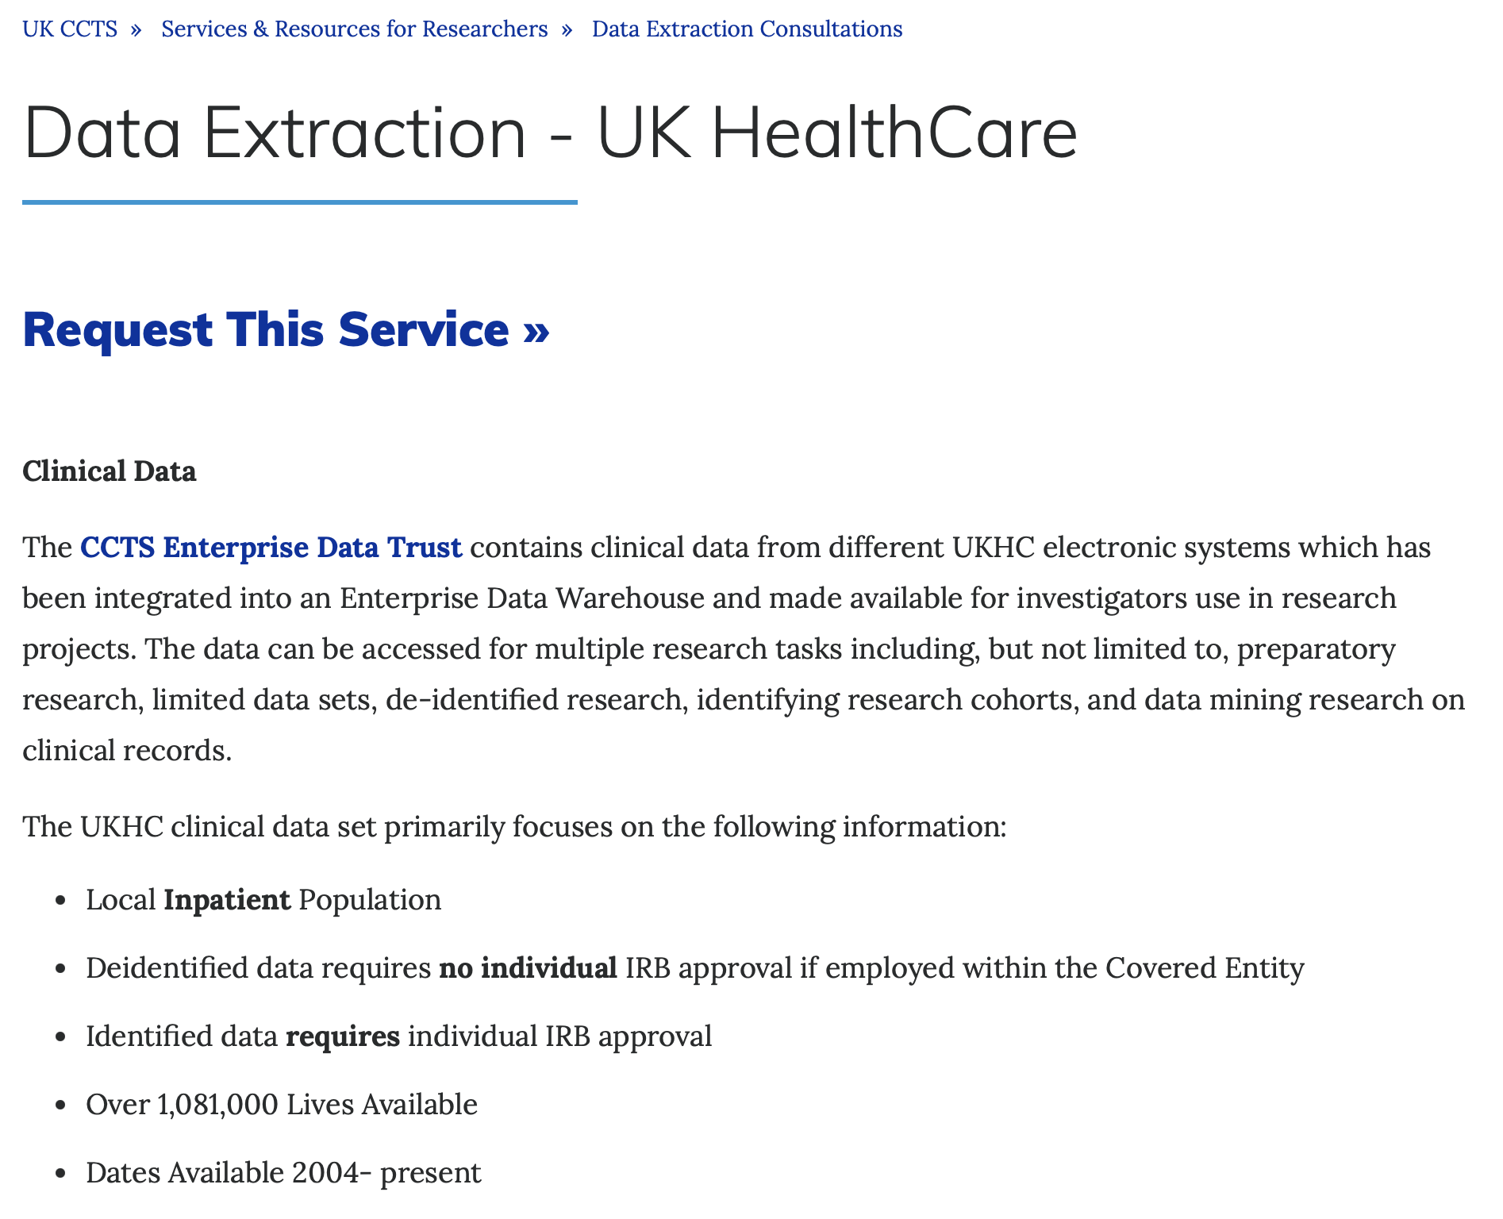
WWW.CCTS.UKY.EDU

Slide 9
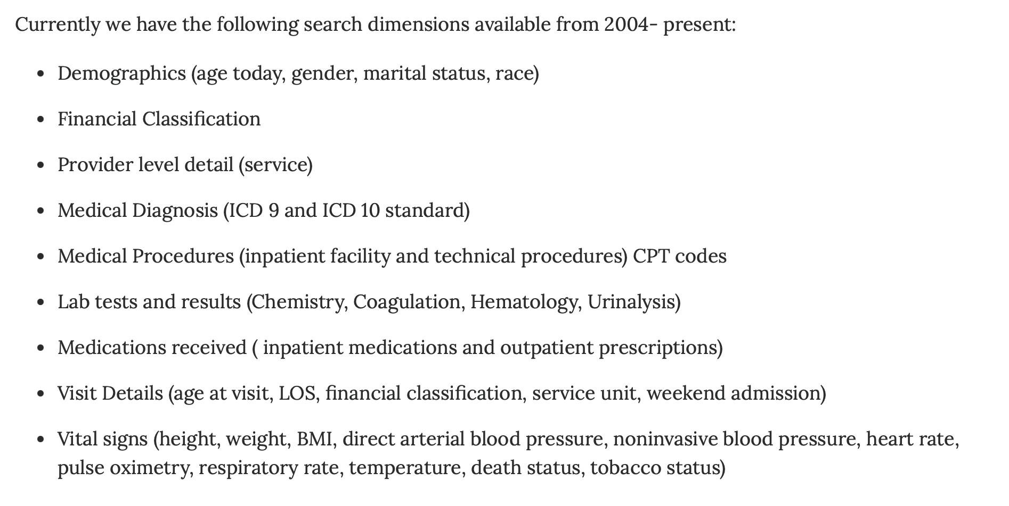
WWW.CCTS.UKY.EDU

Slide 10
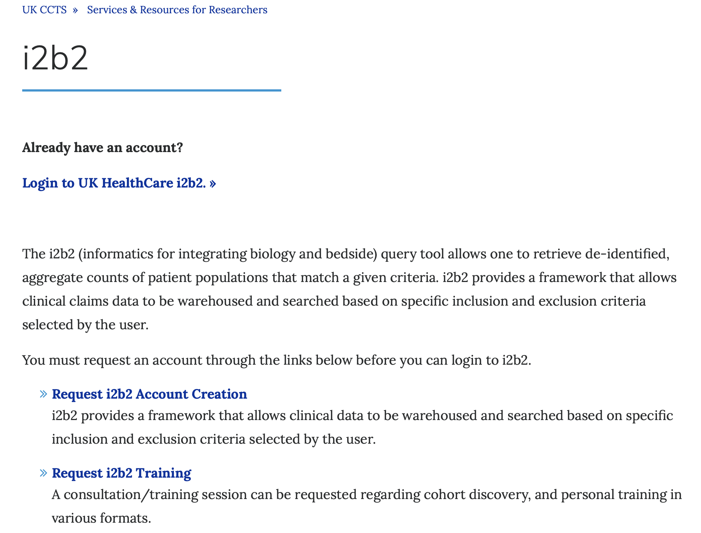
UK i2b2, TriNetX, and the ACT Network
Investigators can query the UK patient data via i2b2 and/or TriNetX to quickly identify cohorts based on diagnosis, labs, procedures, age/sex, timing for the index events, advanced inclusion and exclusion criteria
Self service model expedites the delivery of limited or fully identified data set for the cohort(s)

Slide 11
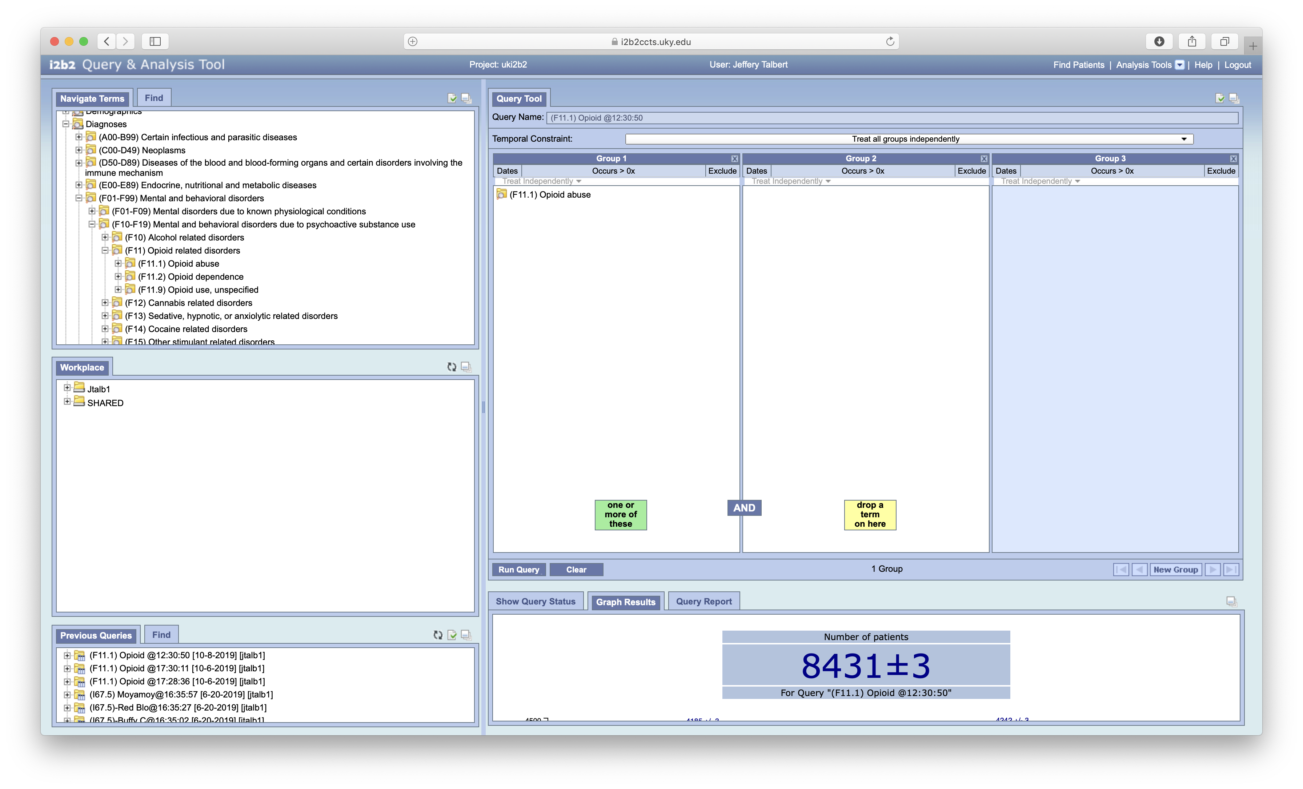
Notes:
No date restriction

Slide 12
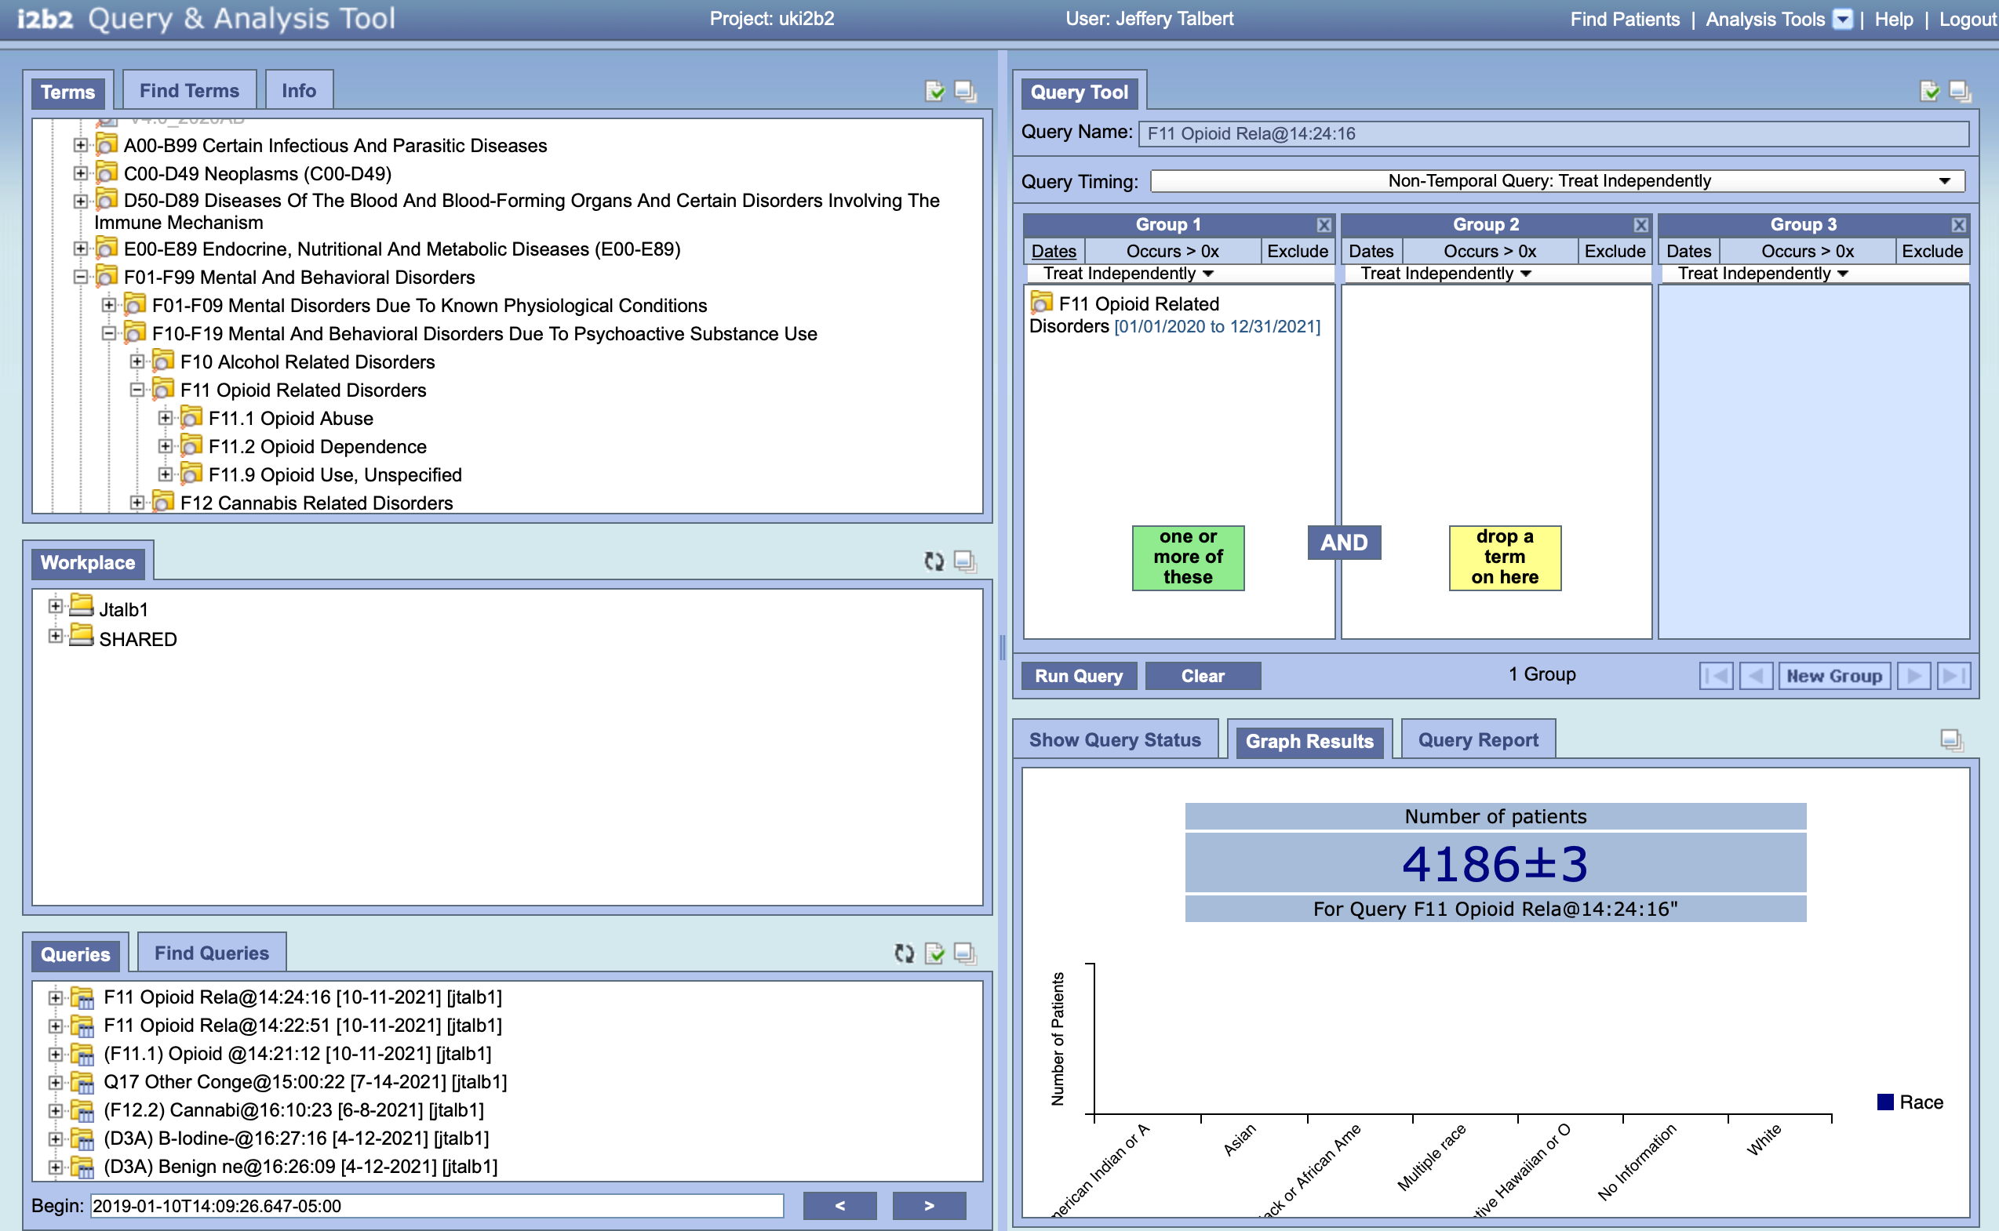
Notes:
Calendar 2018

Slide 13
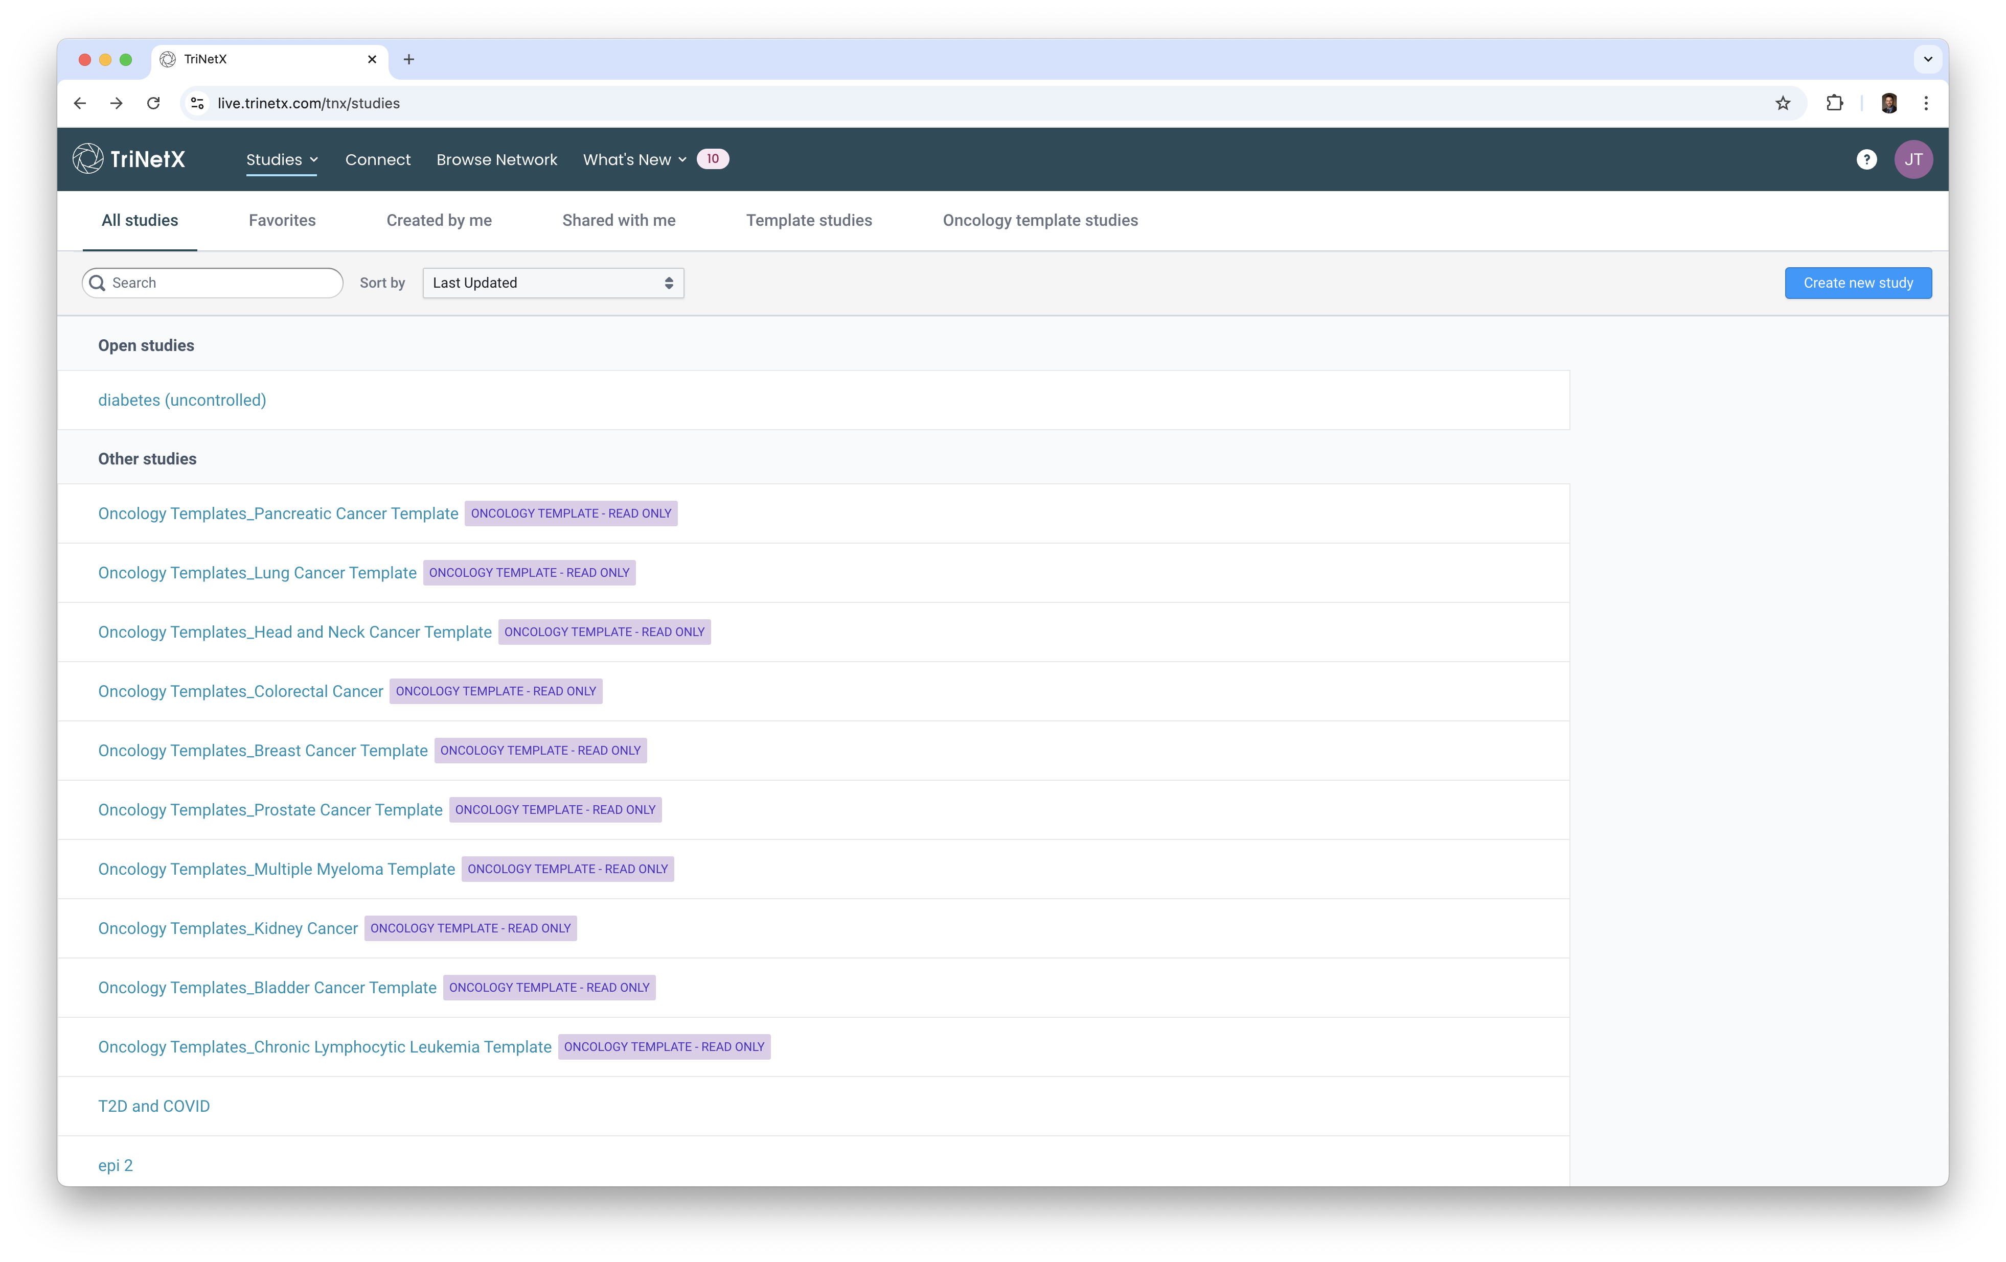

Slide 14
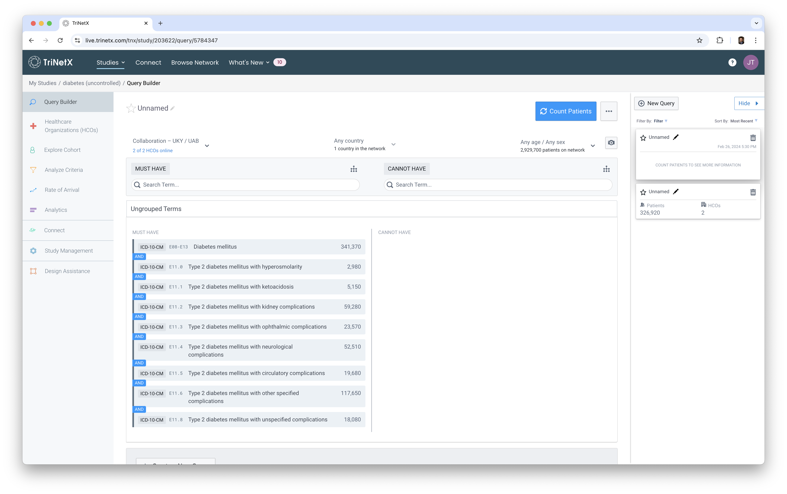

Slide 15
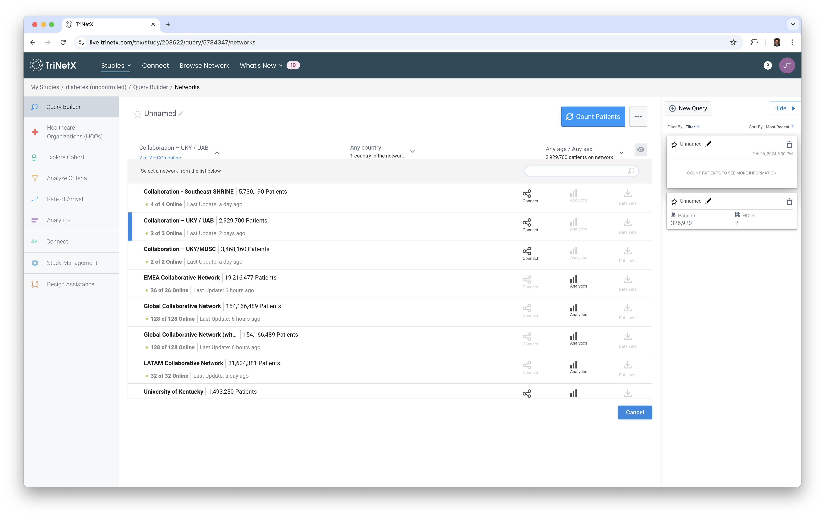

Slide 16
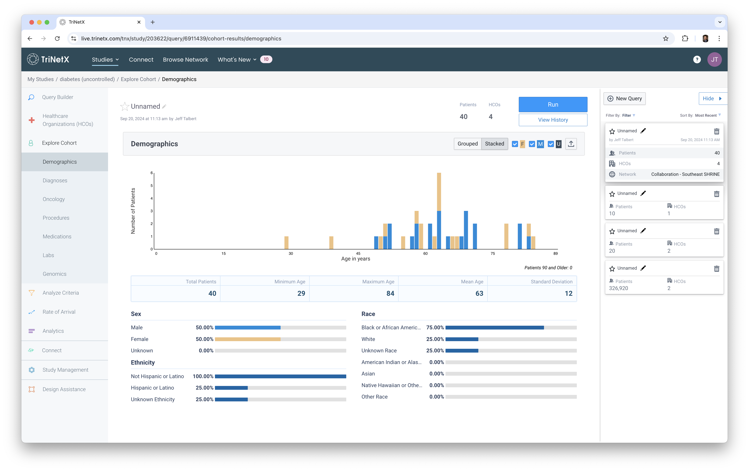

Slide 17
WWW.CCTS.UKY.EDU
MARKETSCAN

Slide 19







The MarketScan Research Databases
I
  Data include
  Eligibility
  Claims
  Encounters
  Rx claims
  Benefit
  plan info
  Discharges
  Clinical
  Productivity
  HRAs
Three Core Claims Databases
Data from 293M+ patients
Commercial
Under-65 working population + dependents
Claims linked to drug, enrollment, and benefit plan design
Medicare
Retirees covered by previous employers
(supplemental and advantage plans)
Claims linked to drug, enrollment, and benefit plan design
Multi-state Medicaid
Medicaid enrollees
Inpatient services and Rx claims, enrollment, LT care, etc.
120+ Employers
40+ Health plans
7-12 States (Medicaid)
  Data preparation
  Standardization
  Linking
  Privacy protection
  Enhancements
  QA/Improvement
  Customization
Specialty Curated Databases
Clinical variables
Health & Productivity Management
Health Risk Assessment
Lab
Benefit
Plan Design
Dental
Core databases: Most recent cumulative counts (2018-2022) | jgjhg |  | Specialty curated databases: Most recent cumulative counts (2017-2021)
Commercial | Medicare | Medicaid | Lab | Health & Productivity Management | Health Risk Assessment | Dental | Benefit Plan Design
45.0M lives | 2.6M lives | 18.3M lives | 5.6M lives | 8.1M lives | 2.2M lives | 18.2M lives | 45.4M lives

Slide 20
Merative MarketScan Multi-state Medicaid Database
Pooled Medicaid data from 7-12 geographically dispersed states
Includes Medicaid managed care plans
Inpatient services and prescription drug claims, plus information on enrollment, long-term care and other medical care
Additional variables:
Race
Medicaid eligibility category
Medicare eligibility
Years | Medicaid database patients
2018-2022 | 18.3M

Slide 21
MarketScan® Lab Database
Years | Lab patients
2018-2022 | 5.6M
Healthcare researchers use these data to understand how well a drug is performing in the real-world clinical setting by looking at lab test results
Inpatient, outpatient, Rx and enrollment data are available for all patient lives
Sample data elements:
LOINC code, lab results reference high range, lab result reference low range, lab result category code, lab result numerical value, lab result units, date serv ice incurred
Notes:
Updated April 2023

Slide 22
MarketScan – Mortality Dataset

Slide 23
MarketScan® Health and Productivity Management Database
Years | HPM employees
2017-2021 | 8.1M
Used to quantify the total burden of illness and calculate employer-based demand management initiatives
Linked medical, drug, enrollment, absenteeism, short-term disability and workers’ compensation data
Includes medical/drug claims and encounters for employees, spouses and other dependents
Data available 1997-2021
Sample data elements:
Demographic | Absenteeism | Short-term disability | Workers’ Compensation | Financial
Enrollee ID | Dates/Hours of absence | Case days | Body part injured | Net payments
Age | Absence type | Disability type | Case diagnosis | Payments to physician
Gender |  | Case diagnosis | Indemnity payments | Payments to hospital
Employment class |  | Total payments | Case day | Total payments
Relationship to employee |  |  | Cause of injury | Payments total admission
ZIP code |  |  | Medical payments
Industry
Notes:
Updated April 2023

Slide 24

MarketScan® Benefit Plan Design Database
Years | BPD lives
2017-2021 | 45.4M
Detailed information about benefit plan characteristics for a subset of the health plans represented in the Commercial and Medicare Databases
Variables are generated by a plan-by-plan statistical analysis directly from the claims data. This greatly automates the development of the dataset, allowing us to increase the number of lives mapped to BPD date versus previous versions by over 400 percent. It also creates an inherent assurance that the linkage to claims is complete and correct.
Sample data elements:
Copays and coinsurance, for various care settings (both in-network and out of network), deductibles, out of pocket maximums / spending limits, plan enrollment start and end dates
The Benefit Plan Design Database allows researchers to do the following:
Evaluate the impact of health plan features on healthcare utilization
Assess the relative performance of plan types with varying managed care features
Include detailed plan provisions, such as copayments, deductibles and coverage options in analysis of healthcare cost and use
Notes:
Updated April 2023

Slide 25

MarketScan® Health Risk Assessment Database
Years | HRA respondents
2017-2021 | 2.2M
Patient-reported health behaviors and clinical data linked to claims data
Standardized HRA data combined with claims yield research opportunities
Key targets for research
Completes the full health and productivity picture along with claims, absence, short-term disability and workers’ compensation data
Potential study areas: obesity, cardiovascular disease, metabolic syndrome, smoking cessation, alcohol consumption, insomnia
Sample data elements:
Biometric information
Height, weight, body mass index (BMI), total cholesterol, HDL, LDL, glucose, blood pressure
Health behaviors
Smoking status, alcohol consumption, sleeping habits, dietary habits, exercise, seatbelt use, fire prevention
Intent to change behavior
Smoking, exercise, diet/weight, stress level, sleeping habits, follow MD advice
Self-assessed health
Physical health, mental health, work absence
Notes:
Updated April 2023

Slide 26

MarketScan® Dental Database
Only integrated medical and dental database available
Includes patients from the Commercial and Medicare Databases (age 65+)
Unique as it includes dental claims for the elderly population
More than 80% of
enrollees have potential pharmaceutical claims
Potential study areas:
Respiratory tract infections
Chronic sinus infections
Diabetes
Chronic acid reflux
Liver or kidney problems
Infective endocarditis
Cardiovascular disease
Preterm birth
Years | Dental patients
2017-2021 | 18.2M
Sample data elements:
Demographic | Provider | Financial | Other dental claims variables
Age | Specialty | Total payment | Dental procedure (ADA coding)
Gender | Setting of care | Deductible | Procedure group
Geography |  | Copay | Service type
Type of dental coverage |  | Coinsurance
Type of medical coverage
Drug coverage
Notes:
Updated April 2023

Slide 27
Unique attributes of MarketScan data
Driven by an employer-sourced Model
Real-World Evidence
Requirements
Completeness
99% adjudicated
Closed-claims
Directly from insurer
Captures all services
Required for successful regulatory submissions for S&AE reporting
Critical for benchmarking
Actual Cost
85% have actual cost
Identifies true cost of care
Non-imputed
Invaluable for burden or care or cost-related studies
Robust evidence for pricing and reimbursement submissions
Tangible source of accuracy
Need for
data precision
Regulatory
HEOR
Epidemiology
Longitudinal
Tracks more patients over extended time period
Continuous patient enrollment 5+ years
Data direct from employers and health pans
Better understanding of health status, medical history and Tx outcomes
Enables larger cohorts
Strengthens regulatory submissions
Representative
All 50 states, broad demographics and age groups
Includes 450+ data suppliers (plans, employers, specialty)
Regulatory: covers data from as many plans as possible
HEOR: leads to more accurate results
Epidemiology: minimizes bias and enhances incidence and prevalence rate measures
Commercial
Rigor of analysis

Slide 28
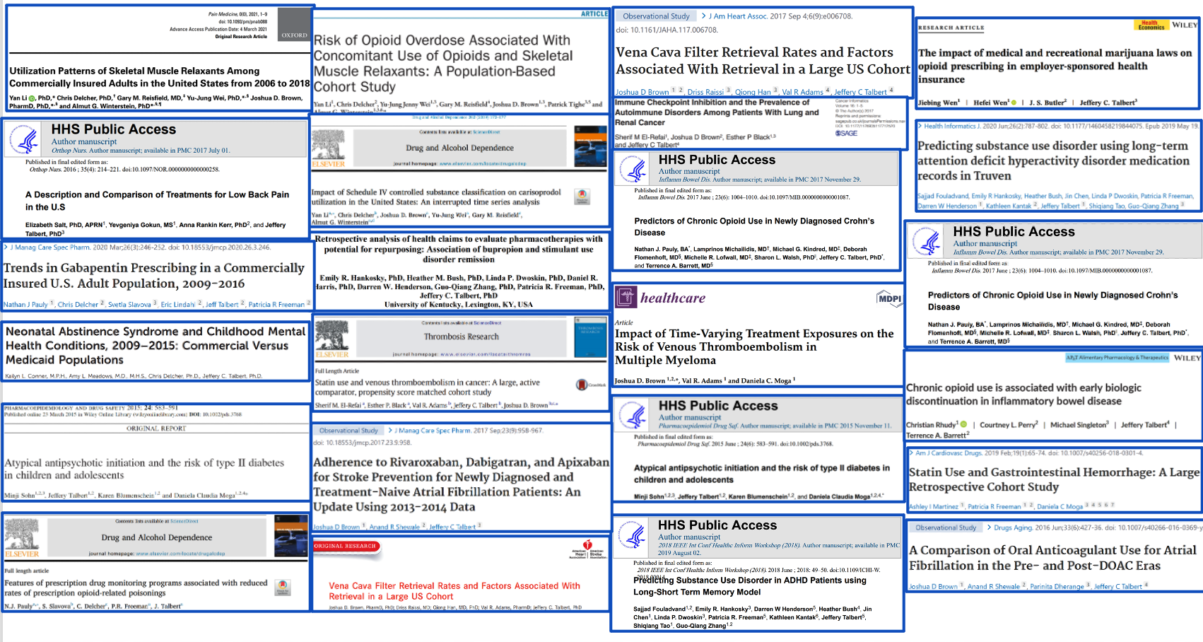
UK MarketScan Example Publications

Slide 29
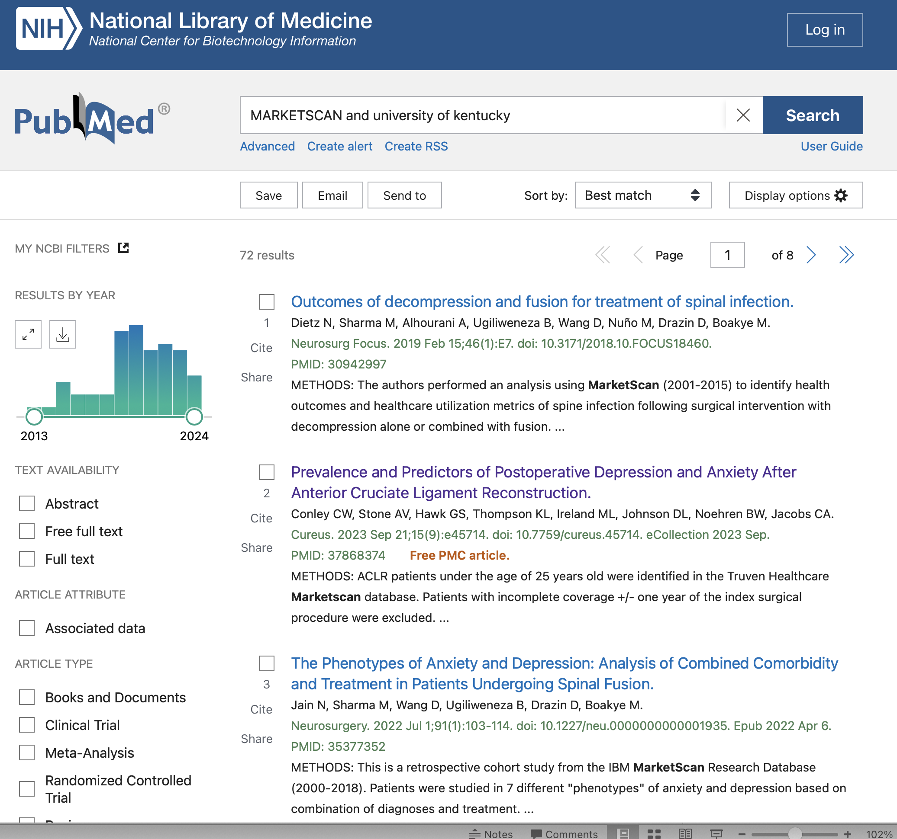

Slide 30
WWW.CCTS.UKY.EDU

Slide 31
KY Hospital Discharge & Outpatient Services Data
  Public use data set provided by the CHFS ODA, data collected through the KHA
  2000-2023 (inpatient)
  2008-2023 (outpatient)
  Dimensions include:
    diagnoses, procedures, demographics (including hospital ID and patient zip), payer, charges, admit source and type
Key factor: Not claims, easier to work with, encounter, not individuals

Slide 32
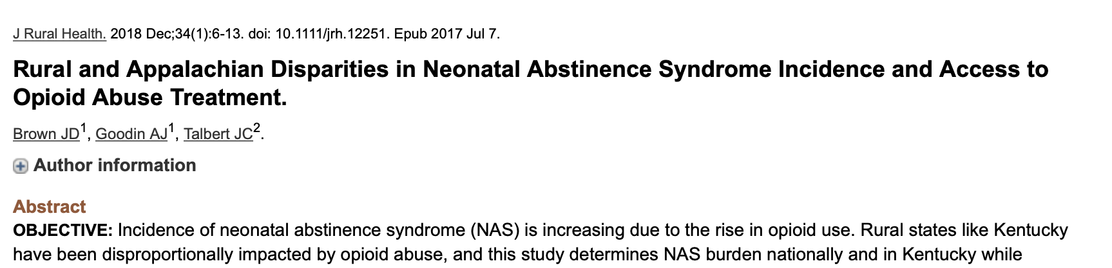
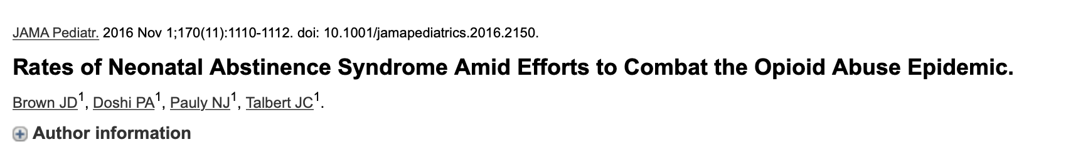

Discharge Data Example Publication

Slide 33
Questions
The project was made possible by the NIH National Center for Advancing Translational Sciences (grant number UL1TR001998) awarded to our institution, which provided access to the MarketScan Health database. The content is solely the responsibility of the authors and does not necessarily represent the official views of the NIH.
Next: Working with MarketScan Data

