Slide 1
Merative Marketscan (FKA: Truven, IBM Marketscan)
Technical/Data POC: darren.henderson@uky.edu DBA
Support: https://support.cctsedc.uky.edu

Slide 2
Expansion of contract – June 2024
Database | Rolling Data Period | Initial Data Period
Commercial/Medicare (Set A) | 15 most recent years | 2008-2022
Standard Quarterly Updates and quarterly Early View releases of the Commercial/Medicare (Set A) | 4 updates annually | 1/1/2023-6/30/2023
Lab Database (Set A) | 15 most recent years | 2008-2022
Benefit Plan Design DB (Set A) | 10 most recent years | 2013-2022
Health and Productivity Management DB (Set A) | 10 most recent years | 2013-2022
Health Risk Assessment DB (Set A) | 10 most recent years | 2013-2022
National Weights | 15 most recent years | 2008-2022
Dental DB | 15 most recent years | 2008-2022
Multi-State Medicaid DB | 15 most recent years | 2008-2022
Interim updates (Medicaid) | 2 updates annually | 1/1/2023-6/30/2023
Commercial/Medicare Mortality Edition | 10 most recent years | 2013-2022
*Source: Letter dated June 26, 2024 from Merative describing the deliverables

Slide 3
Merative Snowflake Environment vs Local
Snowflake is a cloud data warehouse solution
Merative has altered their delivery model to provide licensees access to this cloud environment.
The majority of sets we have licensed have been exported from this environment and loaded locally on our Microsoft SQL Server sv1-sqledt in the TRUVEN and/or TRVNORM databases.
EDC users that have completed trainings can obtain access by entering a support ticket and requesting membership in the data_truven AD security group.
If you would like a user database sandbox provisioned for you on sv1-sqledt, please reach out to darren.henderson@uky.edu

Slide 4
Status of local deployment of Merative data
Database | Rolling Data Period | Initial Data Period
Commercial/Medicare (Set A) | 15 most recent years | 2008-2022
Standard Quarterly Updates and quarterly Early View releases of the Commercial/Medicare (Set A) | 4 updates annually | 1/1/2023-6/30/2023
Lab Database (Set A) | 15 most recent years | 2008-2022
Benefit Plan Design DB (Set A) | 10 most recent years | 2013-2022
Health and Productivity Management DB (Set A) | 10 most recent years | 2013-2022
Health Risk Assessment DB (Set A) | 10 most recent years | 2013-2022
National Weights | 15 most recent years | 2008-2022
Dental DB | 15 most recent years | 2008-2022
Multi-State Medicaid DB | 15 most recent years | 2008-2022
Interim updates (Medicaid) | 2 updates annually | 1/1/2023-6/30/2023
Commercial/Medicare Mortality Edition (see notes) | 10 most recent years | 2013-2022
Notes:
The top 7 entries in the table are present in the TRUVEN database and can be linked together when appropriate for your research by ENROLID.
The second entry is highlighted in a different shade of green to indicate that it is constantly in flux as the annual updates are received. The deliverable letter indicated that we would only receive claims through June 30, 2023, but we did in fact receive claims through Sep 30, 2023. When using Set A tables in the TRV schema of the TRUVEN database, or the normalized data in TRVNORM, the timeframe covered currently is 2008-SEP2023. Note that LABS still ends in 2022. We will not receive 2023 Labs data until ~Dec 2024.
The early view of 2024 is not currently loaded to prevent confusion. Anyone interested in looking at these preview records before they are finalized can request a Snowflake account and query them directly in the Merative environment.
The Dental DB is a stand-alone sandbox of Dental claims data. It does not link to Set A.
The Medicaid DB is a stand-alone sandbox and does not link to Set A. There is an indicator flag if they are dual-eligible for Medicare.
The Mortality edition of Commercial/Medicare is NOT loaded locally. Anyone interested in looking at these preview records before they are finalized can request a Snowflake account and query them directly in the Merative environment. This was a decision we made to prevent confusion or misuse where a user may attempt to link it to other sets erroneously. It is stand-alone.

Slide 5
Demographic differences between Set A and Medicaid
Dataset | STDRACE | REGION/EGEOLOC/MSA | AGE/AGEGRP
Commercial/Medicare | ❌ | ✔️ | ✔️
Medicaid | ✔️ | ❌ | ❌(tbd in-house)
Set A | Distinct Enrollees | Male | Female
Commercial | 191,637,949 | 93,907,403 (49%) | 97,730,546 (51%)
Medicare | 12,553,304 | 5,628,979 (45%) | 6,924,325 (55%)
Medicaid | Distinct Enrollees | Male | Female
Medicaid | 35,130,822 | 15,626,990 (45%) | 19,574,007 (55%)

Slide 6
Set A – Overview (2008-SEP2023)
200,773,748 Enrollees – 198,883,087,291 days of eligibility
61,637,833 Enrollees have at least one span of three years of continuous eligibility where days of eligibility during the calendar years is >=90% of the year.
38,886,127 Enrollees have at least one span of five years of continuous eligibility where days of eligibility during the calendar years is >=90% of the year.
1,044,230 Enrollees are continuously eligible >=90% of the year from 2008-SEP2023.
~10.3B unique diagnostic “events” (enrolid|svcdate|diag_cd tuples)
~12B unique services (enrolid|svcdate|proccd tuples)
635,070,000 Outpatient Prescriptions that map to Medispan GPI (another in-house licensed reference set). Of 1,539,179 that do not map to Medispan GPI, 1,496,991 do have drug information available in the REDBOOK reference table that accompanies the Merative prescription data.

Slide 7
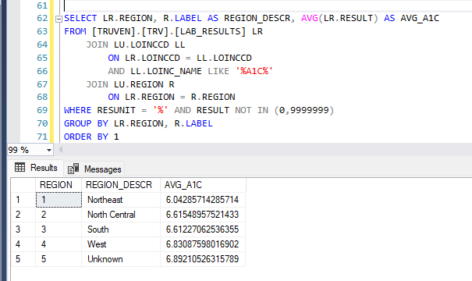
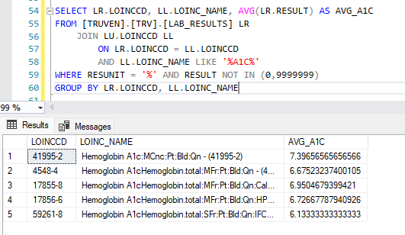
Set A – Overview (2008-SEP2023) cont’d
1,546,625,308 Lab results covering 16,737,790 enrollees across 16,596 unique loinc/test codes.
*Examples of aggregate LOINC based investigations of the population for HbA1c values

Slide 8
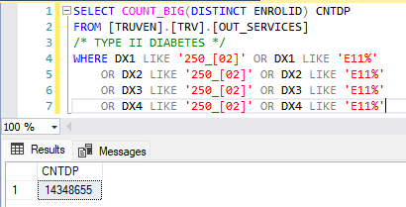
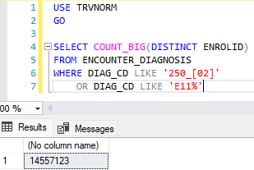
Local TRVNORM normalization work
Set A services are represented in a wide table format that can be onerous to query in some use cases
Example: OUT_SERVICES – 1 record per procedure billed for enrolid|svcdate – dx1,dx2,dx3,dx4 (…dx15 IN_SERVICES)
Queries for patients having a certain diagnosis becomes extra work
Note: You still have to add in that patients found in in_services, in_admits, and possibly facility_header…

Slide 9
Normalization of Marketscan
Treats the ENROLID+SVCDATE as the business key and assigns a new surrogate key EncounterId at build time.
Converts the monthly enrollment data in the ENROLID_DETAIL table into packed interval enrollment spans. New spans created when mutable aspects of eligibility change from month to month.
Unpivots wide data like diagnosis fields into long tables that are easier to query.
Snowflake schema methodology.
In-house data dictionary maintained and available.

Slide 10
Normalization cont’d
Enrolid_detail: Converted month pure eligibility into packed interval elig spans
Assigns new Surrogate key for the eligibility span EnrolidDetailID

Slide 11
Normalization cont’d
Encounter: along with details about the encounter, calculated fields are added during build like is_elig_6mo_prior to indicate if the enrollee had continuous enrollment for 6 months prior to the encounter.
Fields are included to indicate the source tables from TRUVEN each record was ingested from. A user can trace record in TRVNORM back to TRUVEN to inspect the source data.
The EnrolidDetailId the encounter occurred during (based on svcdate between elig_span_begin and elig_span_end is populated) *(0.45% of encounters occurred outside of an eligibility span)

Slide 12
Normalization cont’d
Encounter_Diagnosis: All tables from Marketscan datamodel that contain diag fields are contained in this table. One field diag_cd instead of dx1,dx2,etc.
DIAG_NUM indicates what dx<NUM> field the code was ingested from. !! NOTE: There are known issues in Marketscan where different procedures within the same “encounter” can appear to be billed to a different dx1 or primary diagnosis!!
Additional work done during creation of TRVNORM performed to link diagnosis records to CCS and Charlson categories.

Slide 13
Other TRVNORM resources
ENCOUNTER_PROCEDURE: Procedures billed
ENCOUNTER_CHARLSON: At each encounter, Charlson 10yr survival probability index over the previous year.
ENCOUNTER_ELIXHAUSER: At each encounter, Elixhauser index for the encounter.
PRESCRIPTION: Copy of OUT_RX from TRUVEN DB joined to MEDISPAN GPI data
LAB_RESULTS: Copy of LABRESULTS from TRUVEN DB.
ENROLID_CONTELIG_YEAR: Y/N flag for enrollee 90% continuous elig for calendar year 2008-2023. (270 days used for 2023)
Summary schema: Several tables of aggregate statistics pre-computed. Look here first. The counts you want may have already been run for you!

