Slide 1
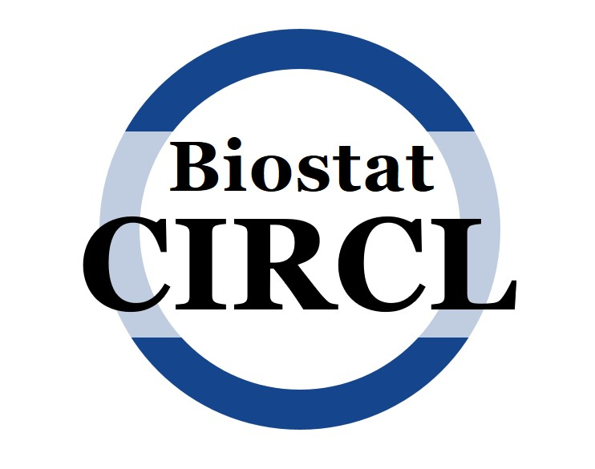
Biostatistics Consulting and Interdisciplinary Research Collaboration Lab (Biostat CIRCL)
https://cph.uky.edu/departments/biostatistics/biostat-circl
BiostatCIRCL@l.uky.edu
Kelsey Karnik, PhD
Biomedical Data Scientist

Slide 2
Who We Are
A group of biostatisticians who specialize in balancing rigorous statistical methodology with the complex challenges of interdisciplinary biomedical research
Director: Dr. Emily Slade, Assistant Professor, Department of Biostatistics
Operating in conjunction with the University of Kentucky's Department of Biostatistics and Institute for Biomedical Informatics
With support from the College of Medicine and College of Public Health
CIRCL Members who know/have used MarketScan Data:
Kelsey Karnik, PhD
Tony Mangino, PhD
Kristen McQuerry , PhD
Will Cranford, MS

Slide 3
What We Do
Assist collaborators in applying statistical methods to biomedical and public health research
Our goal is to build strong research teams to optimize data-driven discoveries
We are not a service core; we are an organization that fosters research partnerships for biostatisticians as team scientists.

Slide 4
Who We Help and How to Access
*Both funded by outside sources – individual researchers are not responsible for covering biostatistician costs
Collaborative Unit Projects
https://bit.ly/biostatcirclcollabunit
To initiate collaboration on a new project, complete the Collaborative Unit Project Intake Form
Lead biostatistician for each group will contact to begin collaboration
Current Collaborative Units
Building Interdisciplinary Research Careers in Women’s Health (BIRCWH)
CNS Metabolism COBRE
Emergency Medicine
Family and Community Medicine
Hospital Medicine
Institute for Biomedical Informatics (IBI)
Internal Medicine
KIPRC Overdose Data to Action (OD2A) Surveillance
Neurosurgery
Otolaryngology – Head and Neck Surgery
Surgery // Surgical Oncology
Urology
Voucher Projects
http://bit.ly/biostatcirclvoucher
Apply for vouchers based on availability and expertise of CIRCL Biostatisticians.
Provide access to biostatistical collaboration for short-term, unfunded research projects
Researchers from the College of Medicine and College of Public Health (faculty only)
Voucher-sized projects typically involve data analysis for a manuscript or a statistical analysis plan for a grant proposal.
30-Minute Open Consulting
http://calendly.com/BiostatCIRCL
For quick statistical questions or brief advice (no data analysis), open consultations
College of Medicine and College of Public Health researchers.
Available on a first-come, first-served basis

Slide 5
What Assistance is provided?
Develop statistical analysis plans and perform analyses for manuscripts, unfunded pilot studies, etc.
Write/edit statistical methods and results for manuscripts
Study design and Power Analyses
Grant Preparation

Slide 6
Meeting with a Statistician
Biostatisticians will work together with you to pull data associated with your project
Can advise on which data items to collect
Contact us as you are forming your research question or study design
If you have already started your project, contact us as soon as possible!
Things to consider before the initial meeting
Inclusion and exclusion criteria
Creating a well-defined patient population
Project Aims / Research questions / hypotheses
How are your research questions associated with the data set of interest?
Project Goals
The sooner the better ☺

Slide 7
THANK
YOU
CIRCL webpage: https://cph.uky.edu/departments/biostatistics/biostat-circl
CIRCL Email Address: BiostatCIRCL@l.uky.edu
CU Project Intake Form: https://bit.ly/biostatcirclcollabunit
Voucher Application: http://bit.ly/biostatcirclvoucher
30-Minute Consulting Meetings: http://calendly.com/BiostatCIRCL
CIRCL Members who know/have used MarketScan Data:
Kelsey Karnik, PhD
Kristen McQuerry , PhD
Tony Mangino , PhD
Will Cranford, MS

